Slide 1
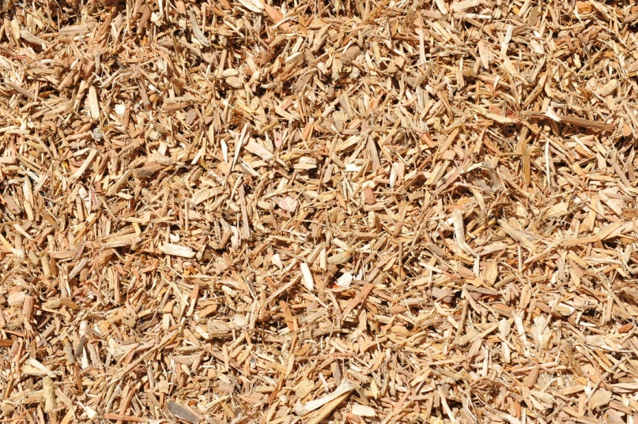
METHOD AND APPARATUS FOR MECHANICAL DEFIBRATION OF WOOD
Aitor Barbero Lopez
Wood Material Science MDP

Slide 2
Introduction
Several known methods for defibration of wood.
Grinding and refining methods used in industrial production but the first closer to the present invention.
  Kneading of wood raw material by pressure pulses and the mechanical separation of fibres.
    The idea of this process is preparing the material for producing pulp for paper making in the subsequent mechanical separation.
  Two obligatory parts.
    Fluctuating pressure for breaking the matrix structure of wood.
    Deformation for softening the wood by the generation of heat energy.

Slide 3
Grinding method
Explained procedure is done by:
  pressing blocks of wood in transverse direction against a rotating cylindrical pulpstone, keeping the longitudinal direction of the blocks of wood parallel to the axial direction of pulpstone.
  The surface of the pulpstone comprises extremely wear-resistant particles bound to each other by means of a softer binder, forming a random particle construction.
    Due to it difference in altitude in the peripheral direction of the surface.
      Generates pressure pulses to the wood raw material
        Separates fibres from the surface wood raw material by means of surface friction

Slide 4
Problem
Use of energy in mechanical pulp production is inefficient.
  Very high energy consumption in Grinding and refining methods
    10 to 100 times the theorical energy consumption
    Due to the high generation of heat

Slide 5
RESEARCH
Grinding surface with an energy-efficient profile
Tomas BJÖRKQVIST & Mikael LUCANDER
A grinding surface profile designed for a more-efficient defibration.
Objective of the design: creating large deformations to generate much permanent structural decomposition in wood.
  Use of low mechanical energy

Slide 6
Introduction
Mechanical pulp production is inefficient from the point of view of the energy.
  Major part of high energy consumption due to the dissipation of energy caused by deformation of wood (viscoelastic material).
    Deformations necessary to make slender paper fibres from stiff wood fibres.
Many estimations about how much energy can be saved.
Main ideas:
  What kind of deformations should be done?
  Under what circumstances?
  ...

Slide 7
Research
Objective: More energy-efficient defibration surface based on modelling of the viscoelastic behaviour of wood.
In grinding protrusions on the pulpstone surface cause cyclical mechanisms that weaken the wood structure.
Protrusions also separate fibre from wood matrix by a combing action.
New surface designed to work efficiently in both phases:
  The kneading phase
  Fibre separation and treatment phase

Slide 8
Research
In this research action source of griding divided in two parts:
  A large scale base profile on the surface (first phase)
  Surface roughness of the profile (second phase)
Both phases controlled independently.
Hypothesis: large deformations most efficient way to produce permanent structural changes in wood (work based on this hypothesis)
  Energy saves in first phase if relaxation of next defibration fibres between the deformation cycles.
  Mastering of the second phase using a manufactured roughness.

Slide 9
Use of simulation model for temperature and strain
  To be able to impulse the essential fatigue process in kneading phase.
  First model built as a Voigt-Kelvin solid.
    Compared with temperature and pressure variation measurements from inside the wood.
    Coefficients of elasticity and viscosity determined by indirect measurements.
      Temperature big dependence on them.
        Need to extend the original model
Simulation of wood behaviour as a Voigt-Kelvin solid using the extended model and temperature dependent coefficient.
  Choose proper sinusoidal wave and wavelength for relaxation of fibre between deformation cycles.

Slide 10
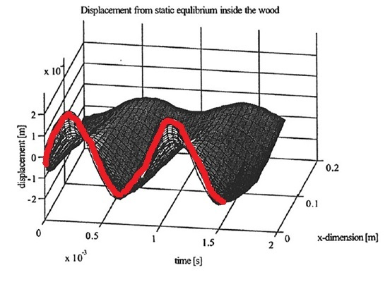
Simulation
Water and fibre suspension not modeled
  Suspension decreases effective amplitude.
Effective amplitude: 0’18 mm
Wavelength: 17 mm
Displacement from static equilibrium inside the wood in the cyclic steady state. The x- dimension is perpendicular to the grinding zone so that the single wave line in the front represents the effective amplitude.

Slide 11
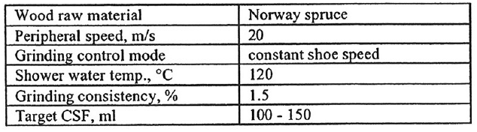
Experiment
Many grinding surfaces analyzed.
Initial stage:
  Grinding surfaces manufactured by coating abrasive microstructures on metallic defibration wheels.
Testing of different wavelengths and surface roughnesses during developing of design method.
Metallic grinding wheel with previous profile (previous slide) very good results
Try to verify the benefits of the base form on a normal 60-mesh ceramic pulpstone.
Process conditions in verification trial
Notes:
Process conditions in verification trial

Slide 12
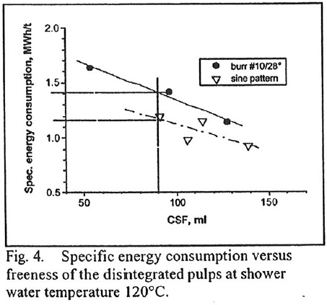
Results
At 120 ºC energy save in the sine wave pattern

Slide 13
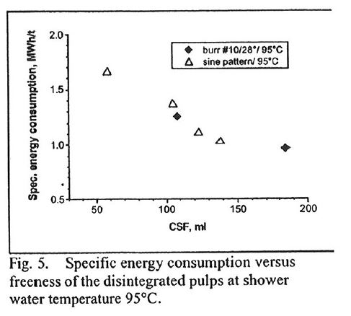
No energy save at 95ºC
Designed for high temperatures

Slide 14
Results
Fatigue action in fibres more efficient than reference pulps.
Fibres loosened from the wood with same or less fibre cutting than reference pulps.
Higher fibre length than reference pulps
Better development of fibre bonding properties. Tensile strengths 10-30% higher than in reference pulps.
Similar optical properties to the reference pulps

Slide 15
INVENTION
Aparatus for mechanical defibration of wood
Author: Thomas BJÖRKQVIST, 5 December 1996
  The idea of the present invention is to produce pulp for paper making with a highly controllable process and with a relatively low energy consumption.
Based on the use of a regular defibration surface instead of a randomly distributed grinding surface
  Randomly distribution: work cycles whose lenght form very even distribution.
  Generates regular pressure pulses depending on peripheral speed employed.

Slide 16
Regular defibration surface is provided with a smaller-scale roughened texture.
  Due to it fibres separated from one each other mechanically.
  Conditions are chosen depending on the desired production, related to relaxation time of wood.
      Relaxation time can be measured experimentally
      Desired defibration surface can be manufactured in different ways
        Machining at first and then coating

Slide 17
Advantages of the invention
Efficiency of energy
  Higher that the industrial methods
    Randomly distribution
      work cycles whose length form very even distribution
      Viscoelastic and non-homogeneous wood raw material in the prevailing conditions falls within a relatively narrow range
      So often the work cycle begins at a wrong phase due to them
        Big deformation and high energy production

Slide 18
    Relatively small part of mechanical energy becomes potential energy
      It represents internal tension of raw material, which breaks the matrix structure and upon relaxation, becomes heat energy
      Half of the work cycle caused by the invention corresponds to the average relaxation time of the wood raw material.
        Probably happens when the required change in the momentum is small
          A large part of the energy can be converted into potential energy stored as tension of the wood matrix
    A large part of it becomes heat energy

Slide 19
In easy words:
  The invention utilizes as much of energy as possible for the breaking of the wood raw material before it becomes heat energy.
    Energy efficiency in the mechanical defibration of wood
  The defibration surface’s properties cause:
    One of them causes the wood raw material to be kneaded.
    The other mainly causes the fibres get separated.
  The method allows those properties to be controlled separately.
    Avoids excessive use of energy

Slide 20
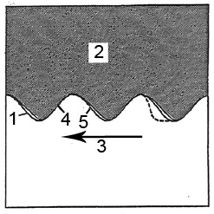
Defibration surface provided with roughtened texture of a magnitude corresponding to the width of the wood fibres.
The wave will have a shape similar to the sine wave (wave pattern advantageous for energy consumption).
Always possible to select a surface speed that a correct cycle lenght is chosen for the defibration
1-Defibration surface
2- Wood raw material
3 – defibration surface’s peripheral speed

Slide 21
How does it work?
Defibration surface moves at a peripheral speed in relation to wood raw material.
Wood raw material subjected to regular treatment: Cycle lenght determined by contour of defibration surface and peripheral speed.
Rising portions of defibration material compress wood raw material.
Falling portion allow wood raw material to expand.
1 -Defibration surface
2 - Wood raw material
3 - defibration surface’s peripheral speed
4 - Rising portion
5 - falling portion

Slide 22
combination of peripheral speed and regular shape of the defibration surface selected:
  Half of the resulting cycle length corresponds to average relaxation time of wood raw material.
  Probably rising portion hit the surface of wood raw material when change momentum required for maintaining the vibration is small
      Much of the consumed energy at first converted into potential energy.
      Stored as tension of wood matrix
        This enables efficient use of energy for breaking the matrix structure of wood.

Slide 23
How does it work?
When tensions build up and relax, some energy becomes heat because of the internal friction of the raw material.
  It varies because:
    Wood needs so much time to recover
    Not possible to have sufficient vibration and warming-up with such a delay.
Relaxation quick at the beginning and slow at the end.
  Avoid using the last part of relaxation.

Slide 24
How does it work?
  use of quick relaxation. When it slows down relaxing we compress it again.
  We separate the defibration surface fibres that have already been kneaded from the wood matrix, by providing a roughened surface.
    New wood raw material on the surface for being kneaded.
    Nature of defibration can be controlled by varying the basic contour and roughness of defibration surface.
    The resulting cycle length must be 1 to 3 times the average relaxation time of wood raw material
      About the half of the cycle corresponds to the average relaxation time.
  Falling portion needs to be changed to achieve protective space for loosened fibres.

Slide 25
METHOD AND APPARATUS FOR MECHANICAL DEFIBRATION OF WOOD
Summary
Method for mechanical defibration of wood:
Kneading wood and separating fibres from the wood by means of the contours of the defibration surface
  Proper distribution
  Regular cycle lenght to the defibration.
    Half of the cycle time correspond to the relaxation time of wood raw material under defibration conditions.

Slide 26
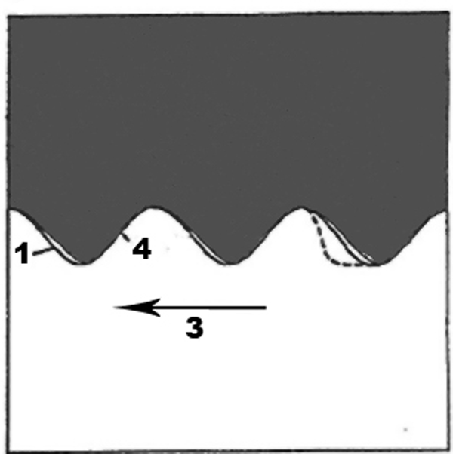
Defibration surface (1) provided in direction of motion of the surface (3) with a wave pattern.
The tops are located at regular intervals.
It coincides with a wave pattern of sine wave at least at the leading portions in the directions of motion of the defibration surface (4)
  Those portions convey energy to raw material

Slide 27
Kiitos
Thank you
www.uef.fi

Slide 28
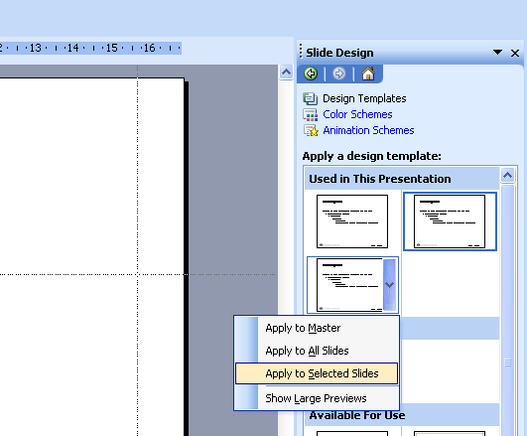
Changing the Design Template:
VIEW>Handout master
OR
Format > Slide Design > Apply a design template: Used in This Presentation > choose one of the three > Apply to All or Selected Slides
www.uef.fi

