Slide 1
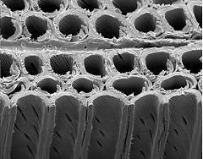
Effects of drying wood
Subheading Palatino Linotype 14pt
Lecture at xxx on 30.10.2008
Vecerova Petra
Forest products and mechanics
Lecture at 8:00-10:00
on 6.10.2014

Slide 2
Literatura
The effect of drying on wood fracture surfaces from specimens loaded in wet condition.
Effects of an impregnation procedure for prevention of wood cell wall damage due to drying.
Ultrastructural characteristic of wood fracture surfaces.

Slide 3
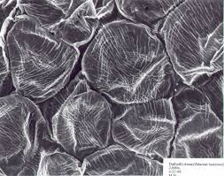
WOOD
Complex:
Heterogeneous
Anisotropic
Formed:
Cells
Form and composition

Slide 4
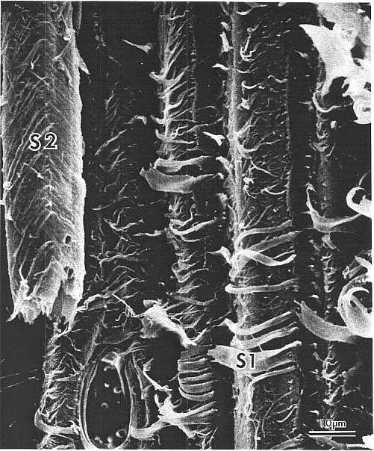
WOOD
Three-layered structure
S1
S2
S3
These symbols refer to the outer, middle, and inner secondary wall layers, respectively

Slide 5
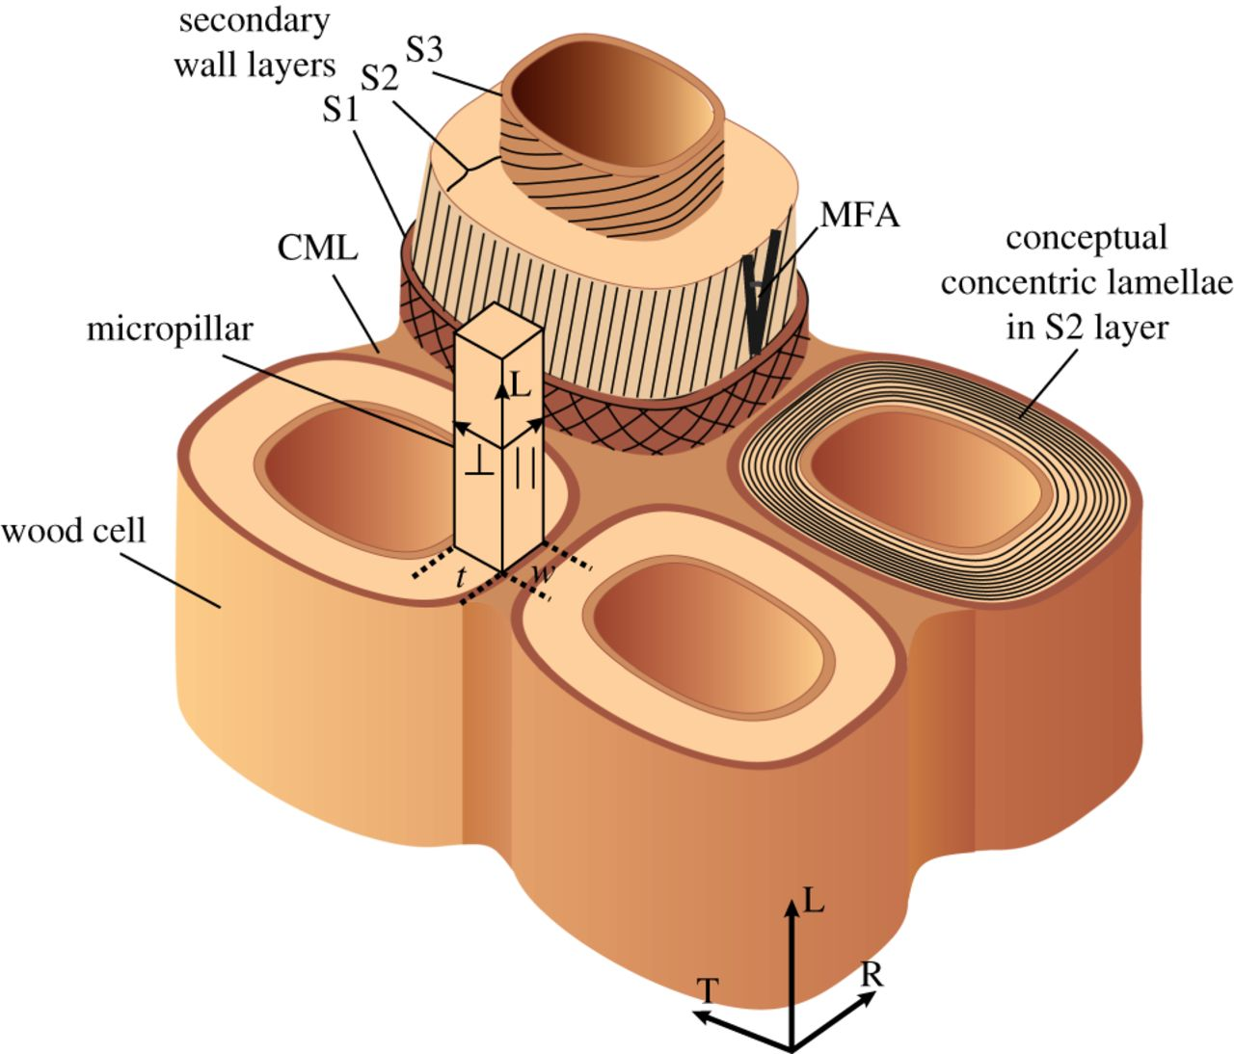
Description of the wood cells

Slide 6
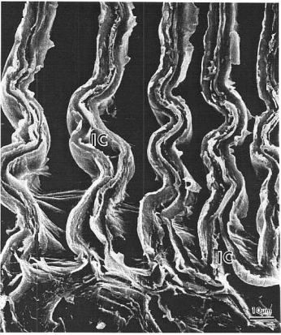
Intercell
Separation of cells at the middle lamella

Slide 7
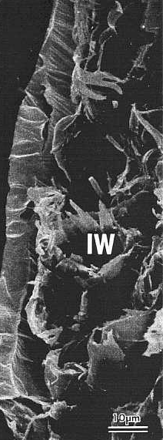
Intrawall
refers to failure within the secondary wall
interface S1/S2 or close to it

Slide 8
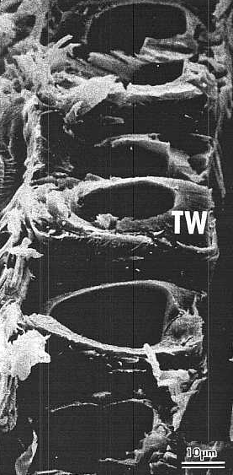
Transwall
When rupture of the wall is complete (when the fracture path cuts across the wall)

Slide 9
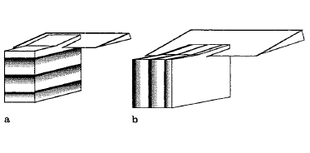
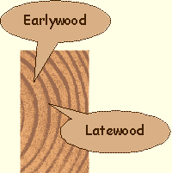
Testing of samples
5 samples Scots pine (Pinus sylvestris)(was split into 2 pieces):
- early-
- latewood
Cut in green condition
Specimens varied between:
Thickness: 0,18-0,56 mm
Width: 10 mm
Length: 30 mm
2 groups:
Preserved in the green condition
Oven-dried and then resoaked
Microtoming of specimens a) earlywood and latewood b) combined early- and latewood

Slide 10
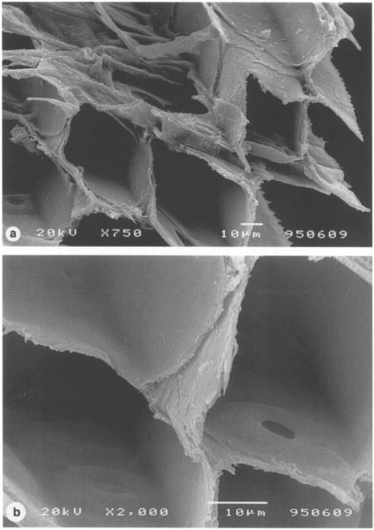
The earlywood fracture surface (green)
transwall and intrawall failure
lower magnification > rough appearance and is highly irregular
the earlywood layer is thinner and the microfibril angle of the S2 layer is more inclined than in latewood cells.
in earlywood, one-third of the cell wall belongs to layers other than S2
earlywood has a higher percentage of lignin and hemicelluloses than latewood
Micrographs of green earlywood

Slide 11
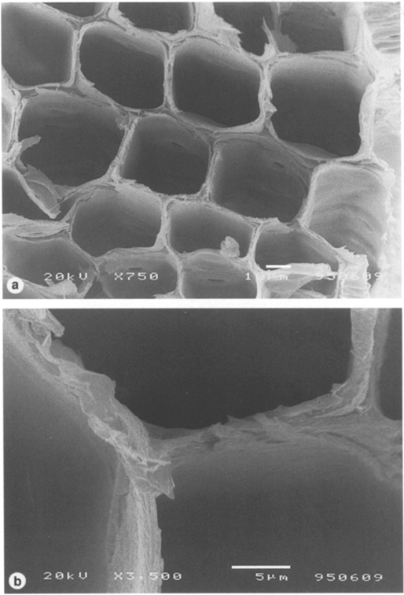
The earlywood fracture surface (resoaked)
transwall fracture surfaces (without intrawall failure)
damage may cause earlier failure initiation.
Also, the crack growth process is likely to be affected by cell wall damage.
In contrast to the green specimens, oven-dried earlywood in the dry state showed brash fracture surfaces in their studies. Although our oven-dried samples were resoaked and tested in the wet state, they also showed similar fracture surfaces as in the studies referred to.
Micrographs of the resoaked earlywood

Slide 12
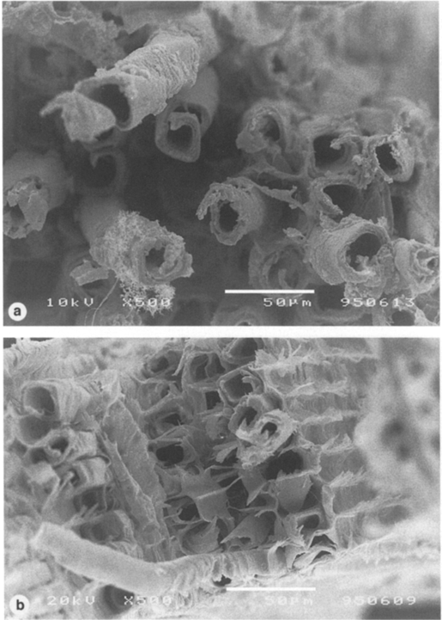
The latewood fracture surfaces (green)
consists of the S2 layer
thicker than the earlywood
predominantly intrawall failure, most likely at the SJ S2 interface
The remaining part of the cell i.e. the S2 and S3 layers, have been drawn out several hundred microns in length
This produces a highly irregular and rough fracture surface.
Micrographs of the green latewood

Slide 13
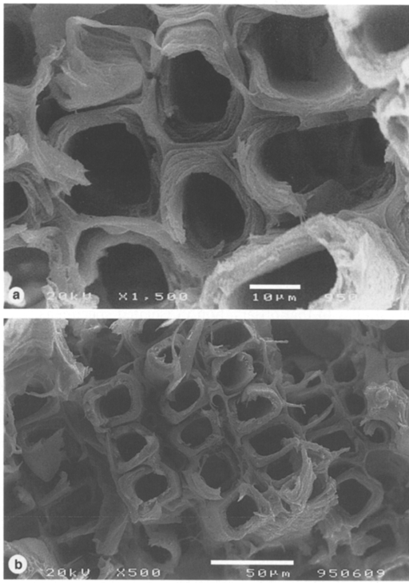
The latewood fracture surfaces (resoaked)
transwall failure dominated.
The resoaked samples showed predominantly transwall failure with very little intrawall failure and very few cells which were drawn out to any significant length.
Micrographs of resoaked latewood

Slide 14
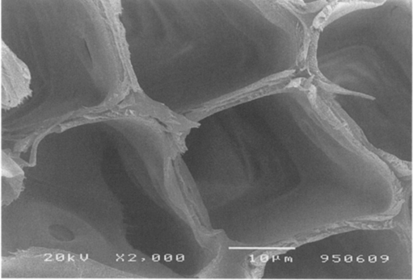
The combined early- and latewood fracture surfaces
For the dried/resoaked specimens, the fracture surface appearance was no different from the specimens of isolated earlywood or latewood layers. However, for the green specimens there was a significant difference.
The earlywood in the combined specimens showed abrupt transwall failure and a much more featureless appearance than the isolated earlywood
64% of the total stress is carried by the latewood which constitutes only 30% of the cross-sectional area. The strain energy density is therefore much higher in latewood than in earlywood.
The mechanism is supported by our estimate that latewood has a much higher strain energy density than the earlywood.
Micrograph of the earlywood fracture surface in a combined earlz- latewood sample tested in green condition

Slide 15
Drying has a dramatic effect on the fracture surfaces and therefore on the fracture mechanisms of wood.
irreversible cell wall damage → during wood drying
the strength is lower for samples tested in the dried/ resoaked state
The present fracture surface study provides support for the hypothesis of irreversible cell wall damage from drying and demonstrates a strong effect on the failure mechanisms in the wet state. Both green earlywood and latewood showed
rough fracture surfaces, which for latewood was dominated by intrawall failure.
However, in the dried/resoaked state transwall failure dominated and fracture surfaces were more flat, indicating a more brittle fracture process

Slide 16
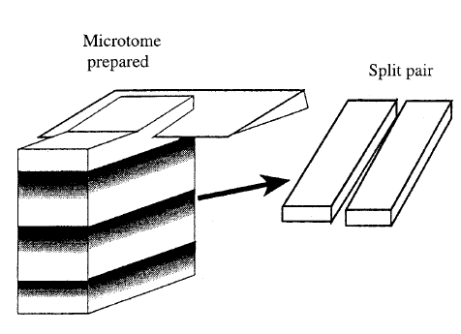
Experiment
Sample: green sapwood of Swedish pine (Pinus sylvestris)
Thickness- 0,2-0,8 mm
Length- 30 mm
Width- 4 mm
Specimens of similar microstructure (from the same annual ring)
2 separate treatments:
Specimen was soaked in a solution of water and glycerol („green/impr“)
Just stored in water („green“)
Vacuum- 30 min (to facilitate removal of air from the specimens subjected to impregnation)
Oven drying at 103°C
Schematic illustration of specimen preparation by microtome cutting

Slide 17
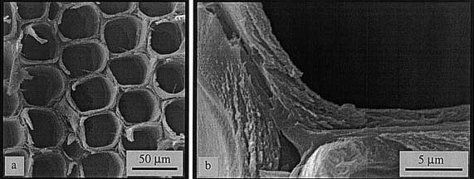
Experiment with green state dried sample
Fractography micrographs are presented for the non-impregnated dried specimens
The surface appears flat and failure appears to be dominated by brittle transwall fracture
As the scale of the cell wall see Fig. b, the impression on the brittle fracture remains.
SEM micrograph of fracture surfaces resulting from test for tensile strength parallel to grain. Non-impregnated specimen tested in the dry state: a low magnification revealing cellular structure; b higher magnification at the scale of the cell wall thickness

Slide 18
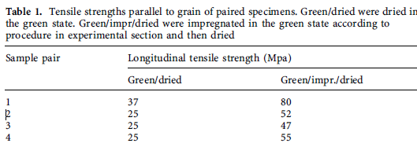
Experiment with impregnate state before dried sample
4 specimens: impregnated sample→ 2x bigger tensile strength then non-impregnated
However, the higher strength of the impregnated specimens is apparent.

Slide 19
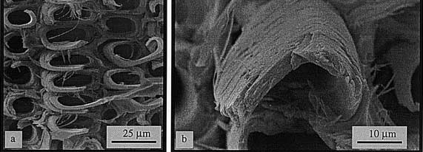
Experiment with impregnate state before dried sample
the fracture surfaces > a very different appearance
Cracks may fail an individual cell wall layer but then often grow between two layers
The observed fractography results correlate well with the strength data in Table 1.
The weaker non-impregnated dried specimens show a more brittle fracture surface appearance.
SEM micrographs of fracture surfaces resulting from test for tensile strength parallel to grain. Impregnated specimen tested in the dry state: a low magnification revealing cellular structure; b higher magnification at the scale of the cell wall thickenss

Slide 20
Drying of impregnated wood/Drying of non-impregnated wood
For wood impregnated in the green state, the impregnating chemical in the cell wall substitutes some of the moisture and therefore limits the drying stresses.
As a consequence, damage is limited so that more of the cell wall ultrastructure in green wood is preserved
Drying of non-impregnated wood leads to very brittle appearance of the fracture surfaces
transwall fracture dominates
the bulking agent reduces the extent of cell wall damage by taking some of the sites otherwise occupied by moisture
During drying, the glycerol stays in the cell wall thus reducing the shrinkage as compared with non-impregnated wood. Absolutely essential for the success of this procedure is that impregnation is carried out as the wood is still in its green, undamaged state
Replace moisture in the cell wall with the bulking agent.

Slide 21
A general problem in studies involving strength of wood is the large scatter in data. One reason for this is the large difference in density between early wood and late wood in combination with differences in annual ring width and the fraction of strong, high density late wood. Other reasons include the sensitivity of strength to defects such as knots, ray cells etc.

Slide 22
References
W. A. Cote and R. B. Hanna (1982) Ultrastructural characteristic of wood fracture surfaces. Professor and Director, and Associate Professor and Assistant Director, respectively N. C. Brown Center for Ultrastructure Studies, State University of New York College of Environmental Science and Forestry Syracuse, NY 13120. 13
G. Kifetew, F. Thuvander, L. Berglund, H. Lindberg (1998) The effect of drying on wood fracture surfaces from specimens loaded in wet condition. Wood Science and Technology 32. Springer-Verlag. 83-94
F. Thuvander, L. Wallstrom, L. A. Berglund, K. A. H. Lindberg (2001) Effects of an impregnation procedure for prevention of wood cell wall damage due to drying. Wood Science and Technology 34. Springer-Verlag. 473-480

Slide 23
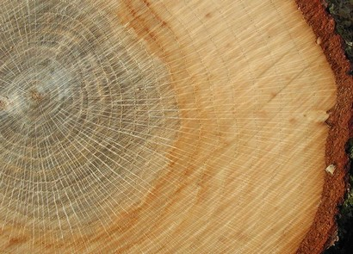
Thank you for your attention!!

